Slide 1
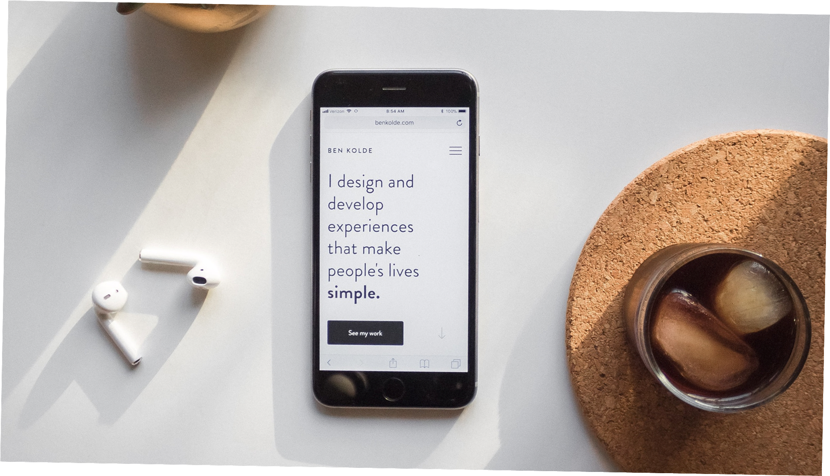
UI/UX

Slide 2
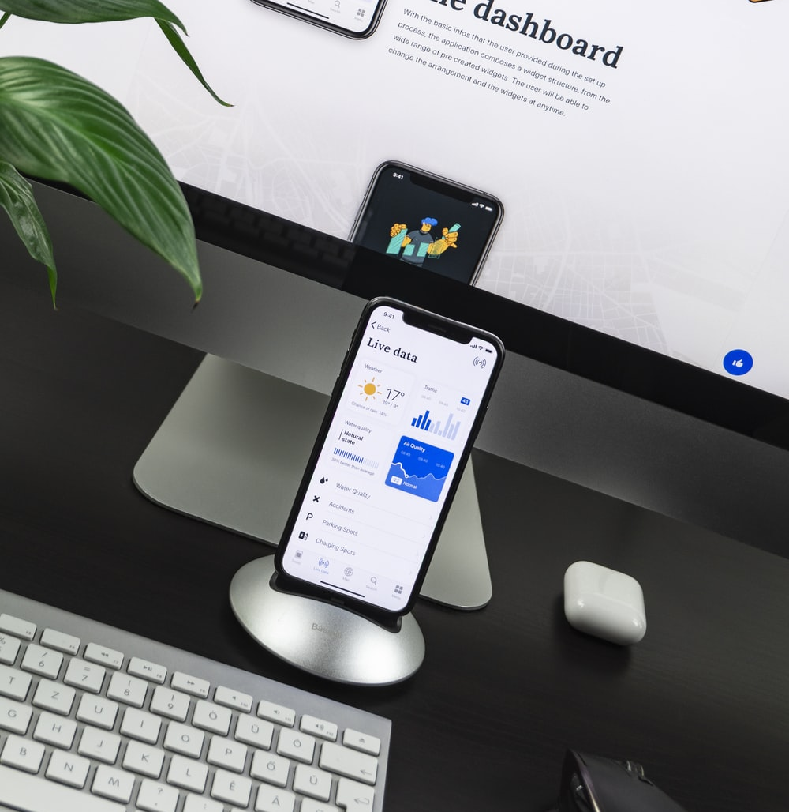
01
AGENDA
Difference Between UI/UX
02
What’s UX
03
UX Process
04
Prototyping Techniques “Tools”
05
Mobile Design Principles
06
Accessibility

Slide 3
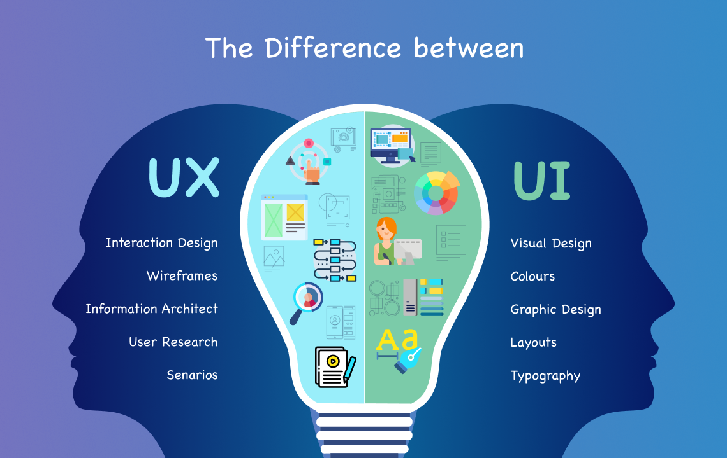

Slide 4

WHAT’S UX?
User Experience
The process of enhancing user satisfaction “persona’s experience “ by improving usability , accessibility , understanding of their behavior and pleasure provided by interaction between user and product .

Slide 5
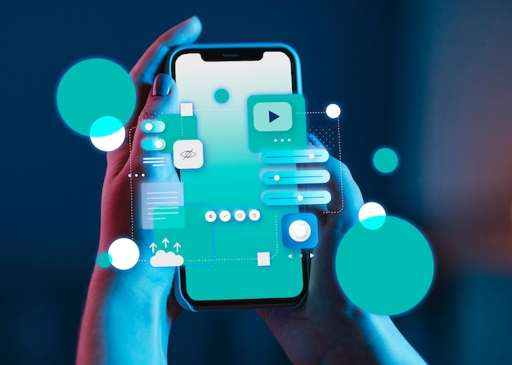
GOOD USABILITY
Simple
Speak the user’s language
Minimize memory load
Use constructive error messages
Prevent errors “avoiding conscious mistakes”
Make clear exits
Give feedback
consistency

Slide 6
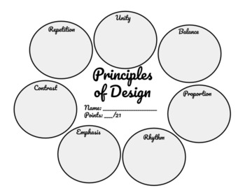
7 VISUAL DESIGN PRINCIPLES
Organize
Economize
Communicate
Proximity
Repetition
Contrast
Alignment

Slide 7
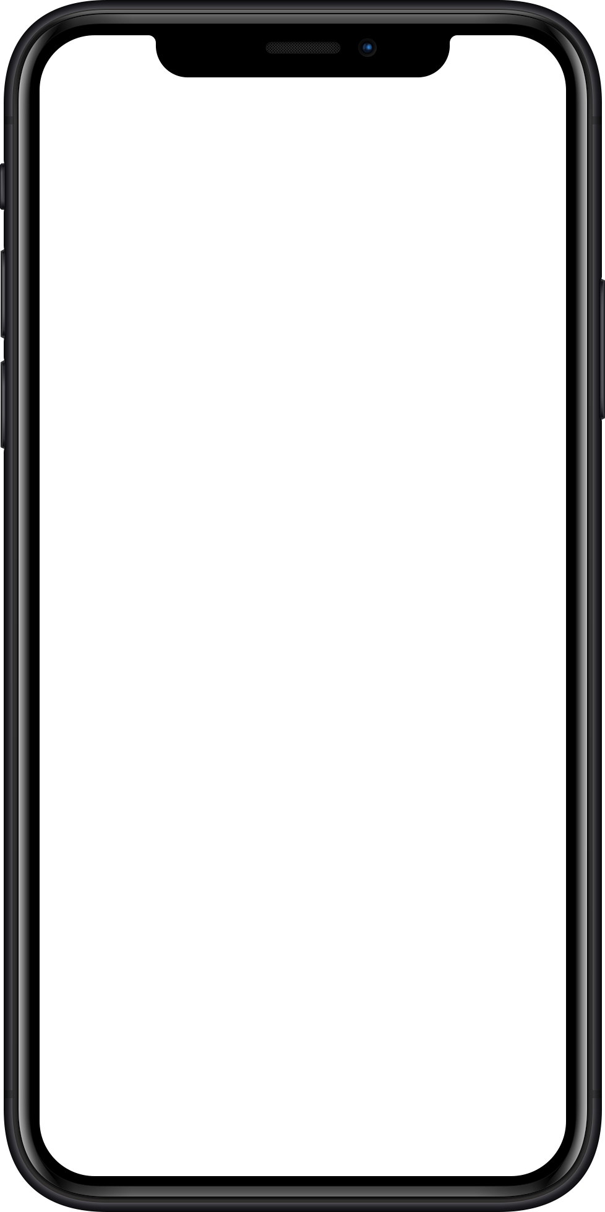

UX PROCESS
Product Definition
User Research
Evaluation
Analysis
Design & Prototyping

Slide 8

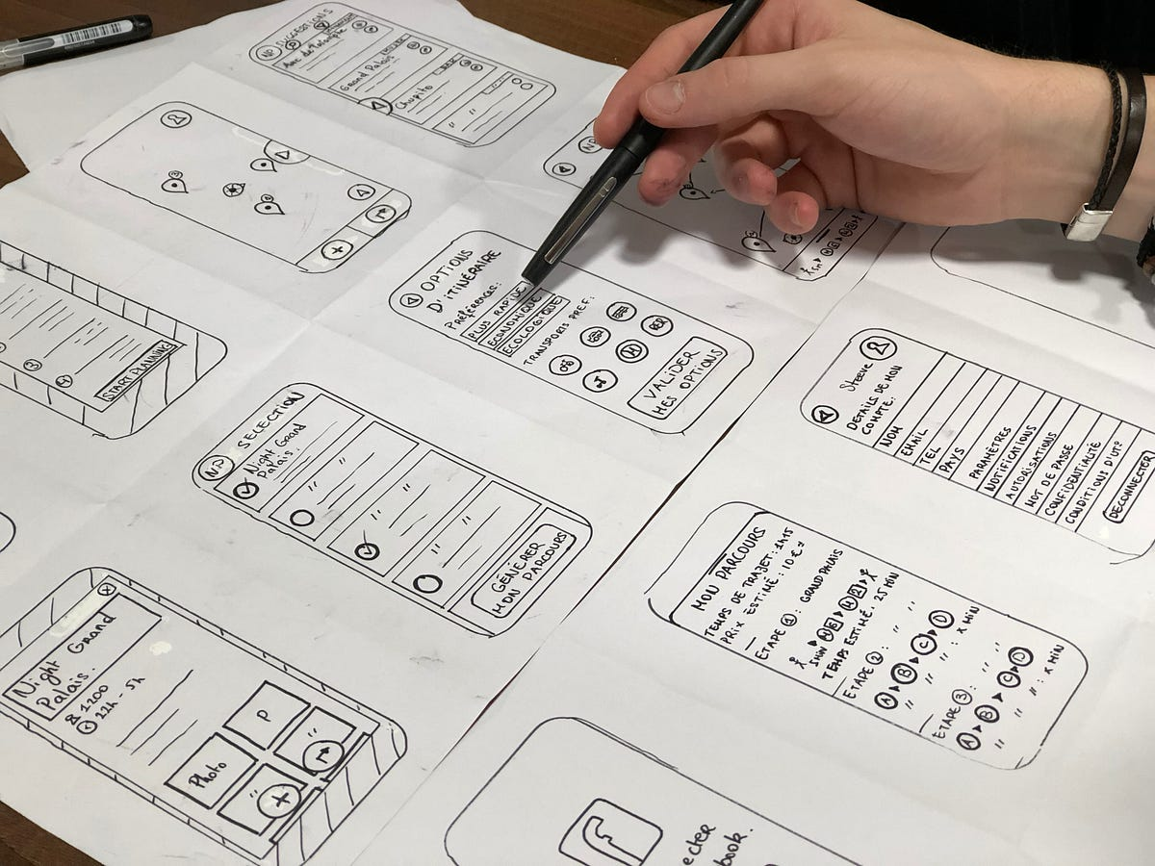

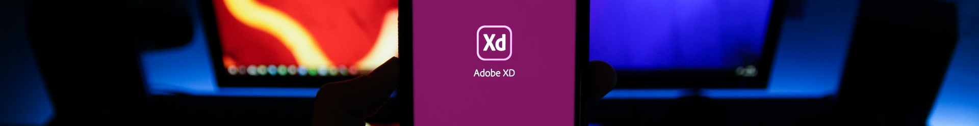
Product Definition
Stakeholders Interviews
Concept Sketching
Create Value Proposition
Defining the goals and values of the product that you would like to build .
Creating an early mockup of what the team is looking to build
What it is , who it’s for and when/where it will be used

Slide 9


User Research
Individual In-Depth Interviews
Competitive Research
Understanding to motivate design by user needs , challenges , problems , activities , knowledge , skills .
Research helps UX designers understand industry standards and identify opportunities for the product in a given area .

Slide 10
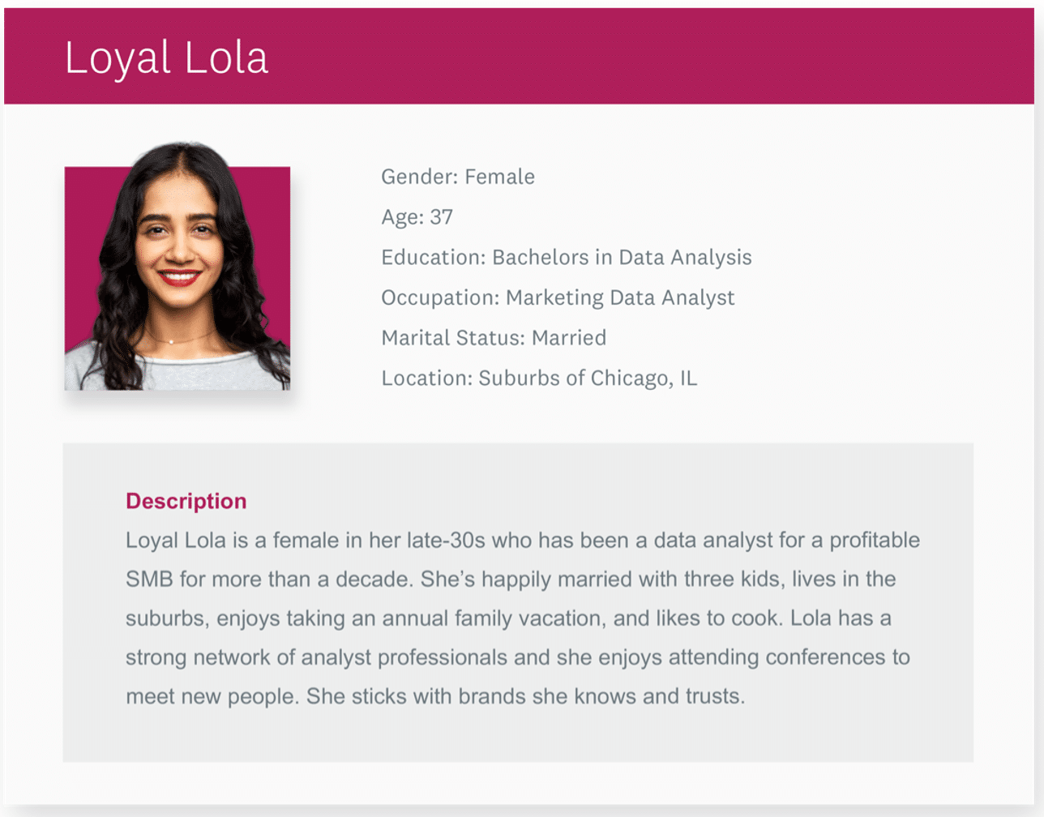
Analysis
Personas
Personas are fictional characters created to represent the different user types that might use a product in a similar way .

Slide 11

Give TEN Examples , Mention The Reason And Define What Kind Of Patterns It Is:
Good website design and bad
Good product design and bad
Good app design and bad

Slide 12
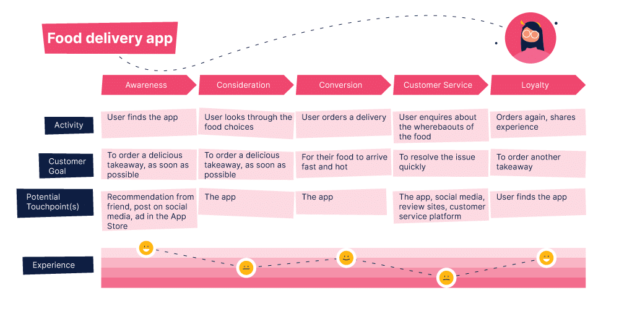
Analysis
Create Experience Maps
An experience map is an important design tool to understand the product/service interactions from users’ point of view

Slide 13
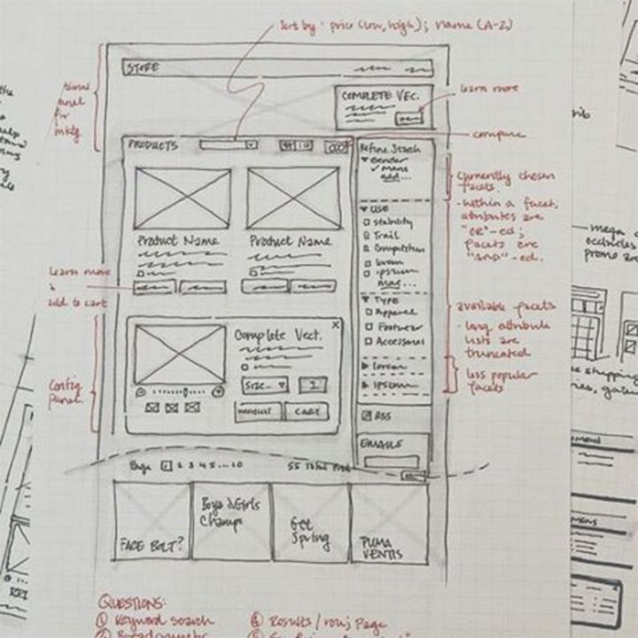
Design & Prototyping
Sketching
Sketching is the easiest way of visualizing our ideas .

Slide 14
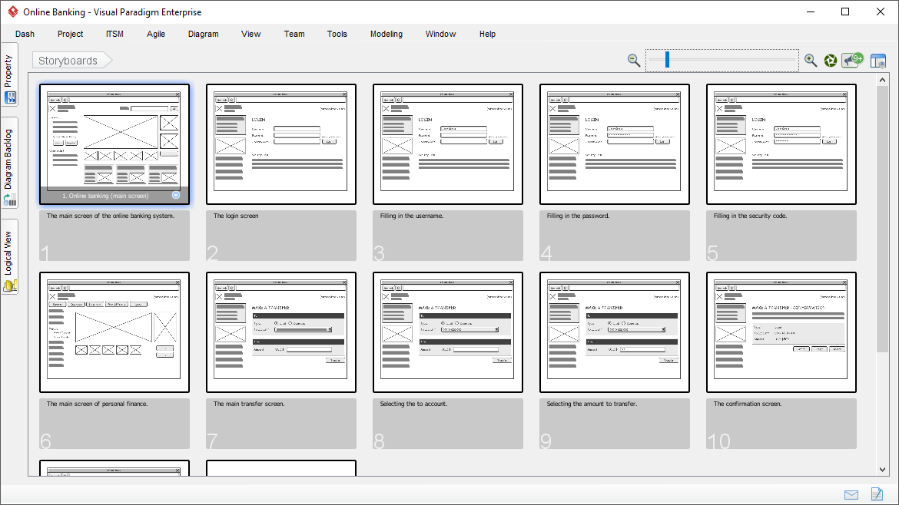
Design & Prototyping
Wireframes
Wireframe is a visual guide that represents the page structure , it acts as the backbone of the product .

Slide 15
VALIDATING & Evaluation
Eat Your Own Dogfood
User Testing Sessions
Once the design team has iterated the product to the point where it’s usable , testing it with the product team is great low-cost validation technique .
Use testing sessions serve as a validation of design based on tools with real users .

Slide 16
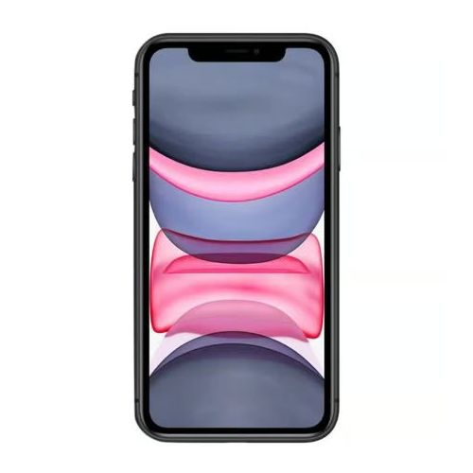
PROTOTYPING TECHNIQUES “TOOLS”
Powerpoint
Mockflow
Popapp
Visio
Balsamiq
AdobeXD
Axure

Slide 17
UNIVERSAL DESIGN , ACCESSIBILITY
Blind and low vision
Challenge
Sensory Impairment
Invisible content
Need to be able to interact with device without visual sensing
Need to increase font size

Slide 18
UNIVERSAL DESIGN , ACCESSIBILITY
Attention deficit hyperactivity disorder
Cognitive Impairments
Lack of focus
Slow input

Slide 19
UNIVERSAL DESIGN , ACCESSIBILITY
Motor Impairement
Physical Limitation
Low pointing dexterity
Inability to use pointing devices
Slow input

Slide 20
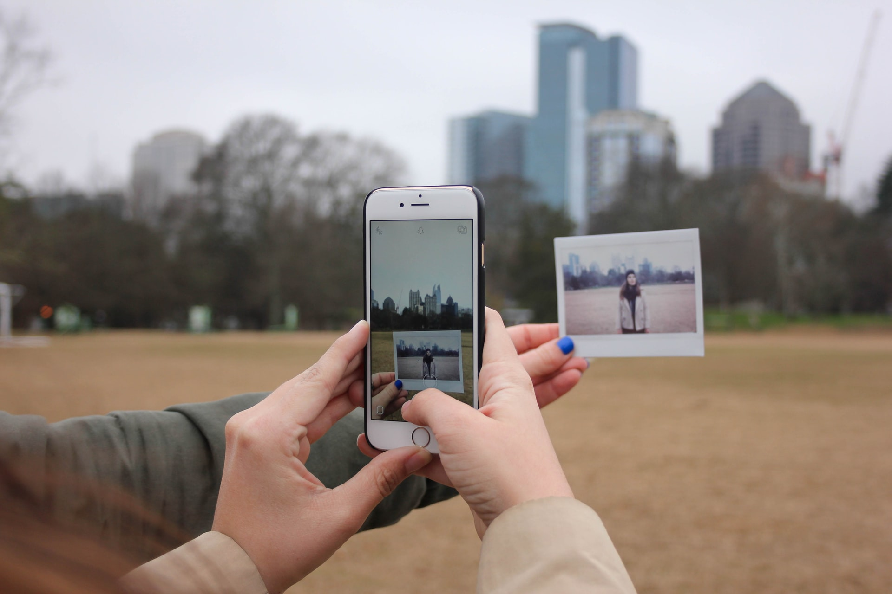
DESIGN PRINCIPLES
Visibility
Feedback
Mappings
Constraints

Slide 21

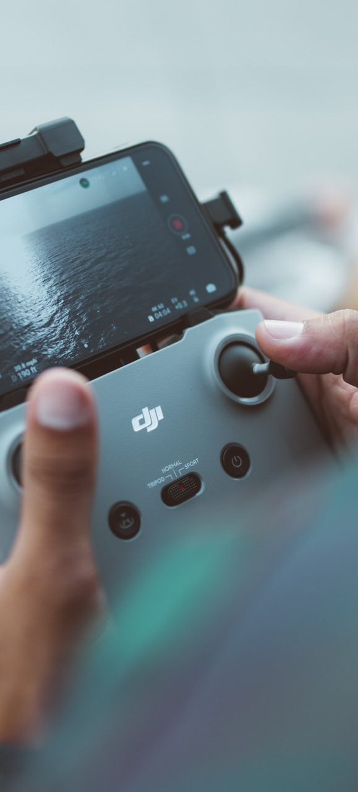
THE POWERFUL OF MOBILE UX DESIGN
The most important thing to keep in mind when designing a mobile app is to make sure it’s both useful and intuitive
If the app is not useful ,it has no real value for user and no one has any reason to use it
If the app is useful but requires a lot of time and effort , people won’t bother learning how to use it
Users install your app because they need to solve a problem , think about what’s your users will be trying to accomplish and focus on their goals , remove all obstacles from their way

Slide 22
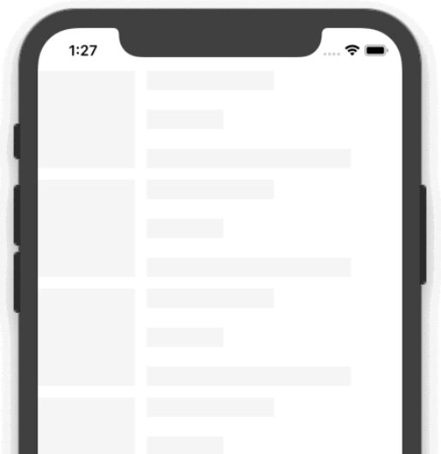
SKELETON / LAZY LOADING
The skeleton view makes your app feel faster
Users are more time sensitive than you think
Research by google suggests even delays as small as 200ms push users away

Slide 23

ACCELERATOR
Allow users to perform actions or view content more efficiently
The take way is that all these shortcuts are hiding in plain sight-facilitating or doubling functionality without adding extra buttons to this screen

Slide 24

ONE HANDED USAGE
Makes your app easier to use on larger screens as well as on regular-sized devices where you only have one hand available
To allow for one-handed usage , navigation and primary actions must be possible without repositioning the holding hand or use a second one

Slide 25
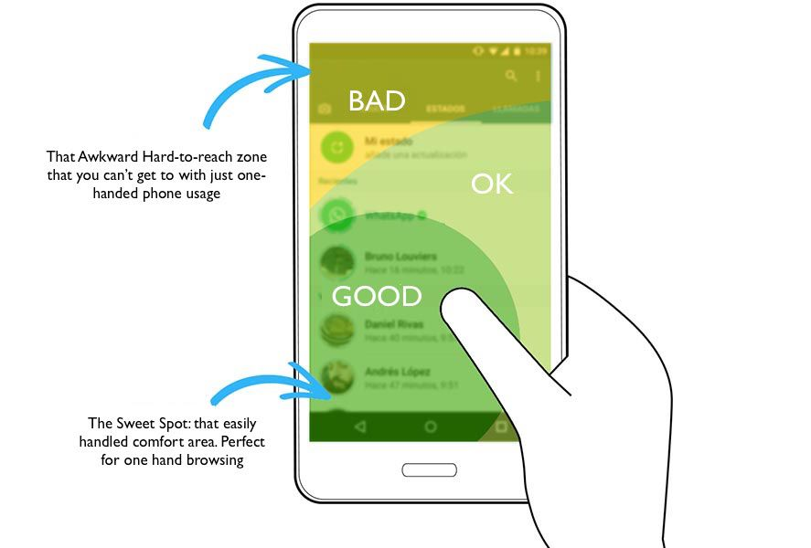

Slide 26
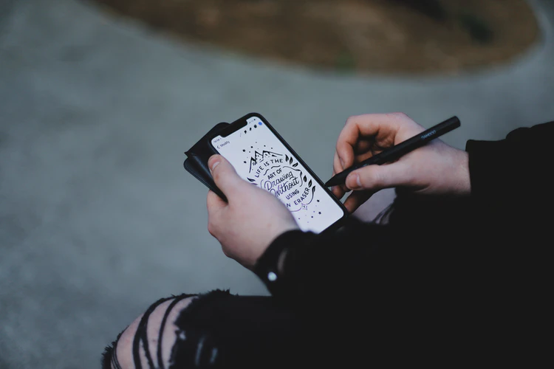
INTELLIGENCE
A computer should never ask the user for any information that it can auto-detects , copy or deduce
Users expect your app to have some basic intelligence , they’ll use it more and rate it higher
Give the user an opportunity to review and accept suggestions
Explore and understand available sensors such as camera , GPS and others

Slide 27
Make Your Persona Then:
Design A Mockup Website According to the information mentioned in your persona
Design A Mobile Application
“You can use PowerPoint , figma or xd / 4 pages at least”

Slide 28

Contact us
ryhabfarouq73@gmail.com

Slide 29
THANK YOU

